Slide 1
AutoConnect
By Armen Krikorian

Slide 2
Contact Information
Team Members:
Armen Krikorian krikorad@mail.uc.edu 513-431-9044
Project Advisor:
John Gallagher gallagj9@ucmail.uc.edu 513-556-2988

Slide 3
Project Abstract
The purpose of this project is to create a reliable OS platform for automobile enthusiasts to use in their personal cars. We want to create a basis that allows for Automobile engine tuning, diagnostic logging, and general comfort features using relatively inexpensive and readily available hardware and software.

Slide 4
User Stories
Story #1: As a user I want to be able to control and modify my cars ECU and diagnostic software, so I can tune them.
Story #2: As a user I want a multimedia interface with my car to interact with, so I can listen to music.
Story #3: As a user I want a to record logs of my engine data, so I can save it off to be further analyzed.

Slide 5
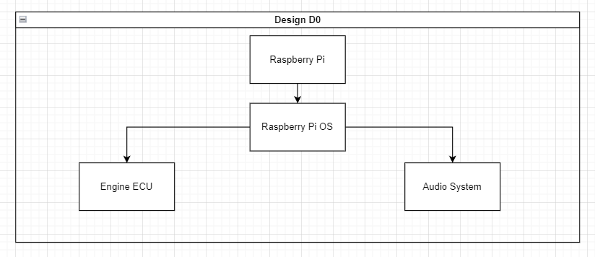
Design Diagrams

Slide 6
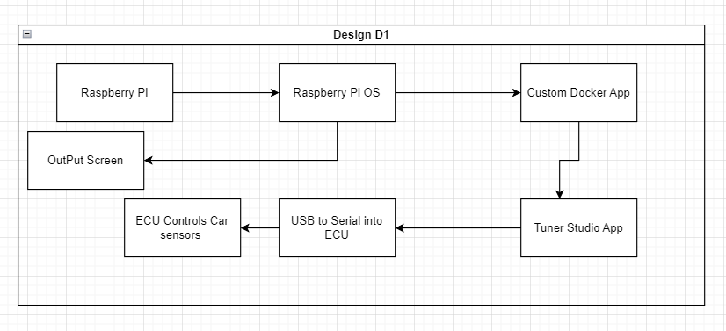
Design Diagrams

Slide 7
Possible Major Project Constraints
Economic
Economic limitations are one of the largest factors in this project. With a very limited project budget and passion for the end product to be easily accessible, efficiently creating something for a low cost, whilst maintaining quality, to the project team and the end user was a main goal. To accomplish this, the AutoConnect team has made the intentional decision to leverage Open Source and popular/universal platforms for its design. This can be seen in the design choice to use Raspberry Pi's for the testing/release platform and the open source tool poky for the development of the OS build. By creating a fork of the already developed Raspberry Pi software, AutoConnect can save on development costs and make a stable product.
Legal
There is constraint from the open source software being utilized. This prevents the product being sold as software directly.
Since this is an automotive based product, especially one that could draw attention away from a driver, it is important for it to be adherent to all legal script related to car based entertainment systems while driving.
This product also features engine tuning and modification capabilities. Some States/Towns have laws against these product so it is necessary to inform end-users one where the product can and cannot be used.
Environmental
AutoConnect will feature software that will allow the end user to modify many parts of their car through software. This is includes, but is not limited to, engine mapping, boost control, and emissions regulation. By increasing fuel consumption and the behavior of the engine, there are environmental concerns and laws. These will be addressed with notices to users about the impacts of different tuning options based on location of use.

Slide 8
Current State of Project
Met with instructed and went of project requirements and technical constraint definitions.
Started to create UI design drawing and concept images.
Focused on putting the scope of the project in writing and making sure the requirements are well laid out.

Slide 9
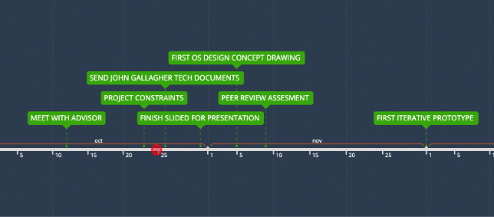
Expected Accomplishments

Slide 10
Expected Demo at Expo
The AutoConnect team plans to bring a video demo along with an in person project demonstration. Since it is unfeasible to bring an entire automobile into a classroom, I plan on showing that part in a video, and bringing a “dummy” functional device to showcase the UI and intended functions of the device.

